Slide 1



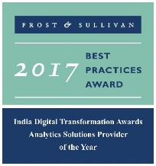


An Introduction
ADE Data on Demand -
LatentView Proposal
Aug 2018
Actionable Insights. Accurate Decisions
2009-2016

Slide 2
Agenda
1
About LatentView
2
Walmart Current Architecture & Evaluation
3
Key Asks For Project Delivery
4
Workplan, Engagement Model and Commercials
5
LatentView’s POV on Evolving Architecture For Diverse Analytical Workloads
6
LatentView’s Data Engineering Capabilities

Slide 3
1. About LatentView

Slide 4







LatentView at a Glance
Founded in
Growing at an average of over
2006
Over
Work with
550
90+ %
30+
San Jose, Chicago, Princeton, London, Bangalore, Chennai, Singapore
People Strong
Fortune 500 Firms
YoY over last 5 years
Awards
Recognition
Member of
2009-2017
Customer council
Rated amongst the top
5%
4/5
10
Repeat business at
>85%
analytics companies to work for in India
Re-investment in Research and Development
top technology companies engage with us

Slide 5













Why we are different
Business led Solutions
Business + Data + Math + Technology
33% of our people have a business degree
Focus on Innovation & Thought Leadership
Institutionalized IdeaLabs for innovation and research
Partnership with IIT Madras to create IIT Data Labs
Leaders in new age Data Platforms
Microsoft Azure Partner & AWS Advanced Consulting Partner
Microsoft’s Gold Analytics Partner
Customized, Differentiated & Technologically scalable solutions
Amplifyr – Platform to understand drivers of customer behavior
Panel Miner – Cloud based data engineering platform to enhance digital user-experience

Slide 6
2. Current Architecture & Evaluation

Slide 7
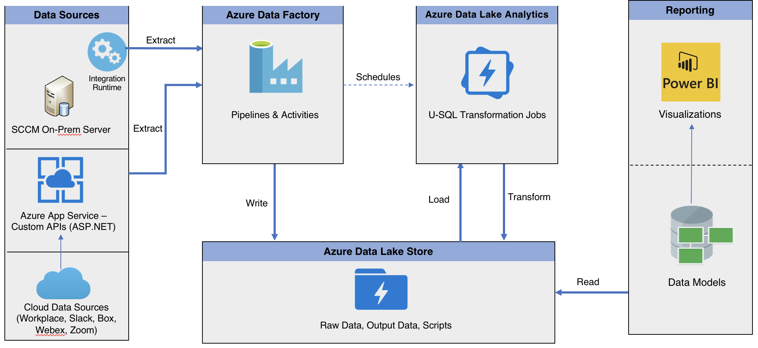
Walmart Current POC Architecture
* As shared by Walmart

Slide 8
Walmart Current POC Architecture - Evaluation
Discovery required for analyzing sources, refresh frequency, reporting requirements
Customizations might be required for diverse sources
Existing Jobs – Not thoroughly evaluated for scale
Discovery required for reporting dashboards specific to business
Report on
Data QA
& Integrity
To be designed based on reporting requirements
Data Storage format and compression to be evaluated for optimal consumption

Slide 9
3. Key Asks For Project Delivery

Slide 10
Key Asks For Project Delivery
Transition team required for on–going implementation sprints from POC to production
Leverage code & design from POC phase to minimize lead time to production
Perform due diligence and discovery to identify business specific reporting requirements
Identify corresponding data sources to meet business requirements
Review existing data transformations to accommodate changes required
Code & Process documentation for effective knowledge transfer
Propose an extensible solution for diverse analytical workloads at scale
Walmart Team to support on
Access to appropriate systems and services
Help evaluate reporting requirements and mapping to data sources
Support in setting up, deployment, testing and productionizing work

Slide 11
4. Workplan, Engagement Model and Commercials

Slide 12
Project Timelines
We intend to adhere to Walmart internal sprint plans in continuous delivery and iteration. The estimate proposed below is tentative and subject to reprioritization based on inputs
Interim Milestone for review & feedback
Activity | Estimated Timeline
 | Sprint 1 |  | Sprint 2 |  | Sprint 3 |  | Sprint 4 |  | Sprint 5 |  | Sprint 6 |  | Sprint 7
 | Week 1 | Week 2 | Week 3 | Week 4 | Week 5 | Week 6 | Week 7 | Week 8 | Week 9 | Week 10 | Week 11 | Week 12 | Week 13 | Week 14
Access set up for onsite and offshore to Azure system and services
Reporting requirements and required data model , Access control lists
Identify data sources , limitations and optimizations for internal review
Reporting dashboard wireframe & review with test data |  |  | 4 data sources |  | 4 data sources |  | 4 data sources |  | Additional data enhancements
Design data pipelines for all required sources, customizations
SLA bound Pipeline Orchestration & Dependency Management
Data Model design; alignment with ETL design |  |  | Review Path to Production |  | Review and Production Rollout |  | Review and Production Rollout |  | Review and Production Rollout |  | Review and Production Rollout
Capturing data in a staging environment & data mart in optimized formats
Aggregate data models to enable analytics reporting & for business consumption, build and iterate on reports/dashboard
Data quality scoring: Log all activities, data & analyze quality of process
Enforce, track & audit the prescribed ACLs, SLAs & schedules
Document code and process flow, metrics lineage
Review Data Pipelines, QA and Data Integrity |  |  |  |  |  |  |  |  |  |  |  |  | Production Support
Review output dashboard and respective functionalties
Discovery
Data Pipelines
(Using Existing Design)
Data Mart
Governance
UAT

Slide 13
Risk Mitigation Plan
Following risks are likely to cause time and budget overruns. We will implement a robust risk avoidance and mitigation plan.
Risk Factors | Severity | Probability | Pro-active Avoidance & Mitigation Plan
Unforeseen complexity of some metrics; dynamic changes in metric granularity | Medium | High | LV will leverage manual & automated methods to expedite the process; Additional buffer already added to the schedule to allow for such slippages
Lack/ delay in consensus on single metric definition | Medium | High | Additional buffer has been added to the schedule to allow for such slippage
Delay in access to documentation on previous analyses of key metrics, data sources, & reports that may require SME outreach; unavailability of SMEs | High | Medium | LV will call out gaps immediately & work with Walmart POC to selectively connect with relevant SMEs for quick turnaround
Mid-project change of scope e.g. inclusion of more metrics or additional deliverables | High | Medium | LV will provide recommendations; will get expedient sign off from Walmart POC
Delay in required access privileges to tools, platforms, databases/ tables/ schemas in Walmart environment | High | Medium | LV will work with Walmart team to expedite the process
Unplanned & unexpected system downtimes | High | Medium | LV will work with Walmart team to find workarounds and continue development in local environments
Delay in receiving work authorization for onsite resources | Medium | Medium | LV will prioritize staffing resources already possessing US work permits; if required premium visa processing of Visas will be done for additional resources
Resource & skill set mismatch and performance concerns | High | Low | LV will review the concern and support the project execution with appropriate resources from the additional buffer
Lack of timely review, feedback and approval by Walmart Point of Contact (POC) | Medium | Low | Additional buffer has been added to the schedule to allow for such slippage
Delay in procurement of requisite licenses for any third-party tools and products | Medium | Low | To expedite matters, LV can procure the same & be reimbursed on actuals
Delays in initial offshore set-up activities due to Security Authorization; legal & statutory compliance | Medium | Low | LV has enterprise wide ISO 27001 compliance; LV to identify requirements and bottlenecks upfront and work with Walmart IT to ensure 100% security compliance

Slide 14



Proposed Team Structure Options & Pricing
Though we have the capability of delivering the solution with a completely onsite team, we would recommend a flexible onsite-offshore model that is highly cost-effective, scalable and efficient
Recommended for short term
Recommended for Long Term (> 6 months)
OPTION 1
(Onsite Visit + Offshore Delivery)
OPTION 2
(Onsite-Offshore Model)
Onsite (US) Visit for 2 weeks
Offshore (India)
Onsite (US)
Offshore (India)
Lead Consultant
Team with varied expertise – BA, DE, Data Architect
Lead Consultant
Offshore Lead
Team with varied expertise – BA, DE, Architect
Additional members will be added as required
Scalable pool of offshore Analysts will be added as required
*Requirements & Scope to be discussed
Proposed Fee: $32K / month
Proposed Fee*:
$49K / month

Slide 15
5. Evolving Architecture For Diverse Analytical Workloads

Slide 16
Ideal Data Ecosystem Vision
LatentView’s Workload-centric architectures help democratize insights beyond data warehousing
CANNED REPORTS
Data Integration
Relational Data Store
& MPP Databases
Enterprise Reporting Platform
Conventional Data Sources
Structured
Data Lake
SELF SERVICE BI
Unconventional Data Sources
Indexing and Querying
API endpoints
OPERATIONAL
External Data Sources
Unstructured
Machine Learning Workbench
ADVANCED ANALYTICS
Distributed Processing
Feature Engineering
Data Sampling
Internal Data Sources
Real time Indexing
(Ex: Elastic Cache)
REAL TIME REPORTING
Data Type specific ETL toolset
Isolating Compute from Storage for Throttle Free, Optimized, Cataloged, Secured and Accountable Single View
Workload Aware Compute
16

Slide 17














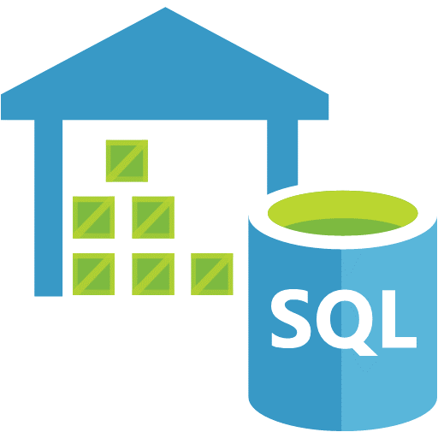









POV on Evolving Data Lake Architecture for Diverse Analytical Workloads
Governance
Raw
Encryption
Technical and Process Metadata
Users and Roles Management
Sharepoint
API
Ad-hoc
Excel
Archive
Canned Reports Server
Alerts
Staging Layer
SQL
Customer Support Data lake
OLAP Cube
RS
Hub & Spoke
Self service Report
eMails
SQL DW
SQL DBs
SSAS
Custom Ingestion Layer
Others
Semantic (Tabular)
Configuration driven orchestrating
Query
Apps
Talend/Data Factory/ Azure Functions
ML/AI Services
Portals
Federated Azure Analytics Warehouse
© LatentView Analytics. Confidential
16

Slide 18
6. LatentView Data Engineering Capabilities

Slide 19
Data Engineering Capabilities Practiced at LatentView
Applications
Data Strategy
Data Lakes
Data Warehouse
Visualization
Decision management systems
IoT Applications
Data Monetization Roadmap
Cloud Strategy & Architecture
Architecture Evolution
Data Integration / Consolidation / Harmonization Framework
Optimizing BI Investments
Data Engineering
Capabilities
Technology
Engineering
Hadoop: Hive, HBase, MapReduce, PiG, HDFS, Phoenix
Spark – Scala, Python, Spark SQL
Flume, Kafka, NiFi, Sqoop
Spark Streaming, Storm
AWS, Azure, Kylo, Qubole, Databricks
Structure Data Flows
Ingest streaming & batch data
Data storage and data model
Batch and Real time processing
Real-time, Graph, Search & Iterative workloads
Orchestration
OCM & Managed Services
Organizational Change Mgmt
Governance
Maturity Assessments

Slide 20
APPENDIX

Slide 21
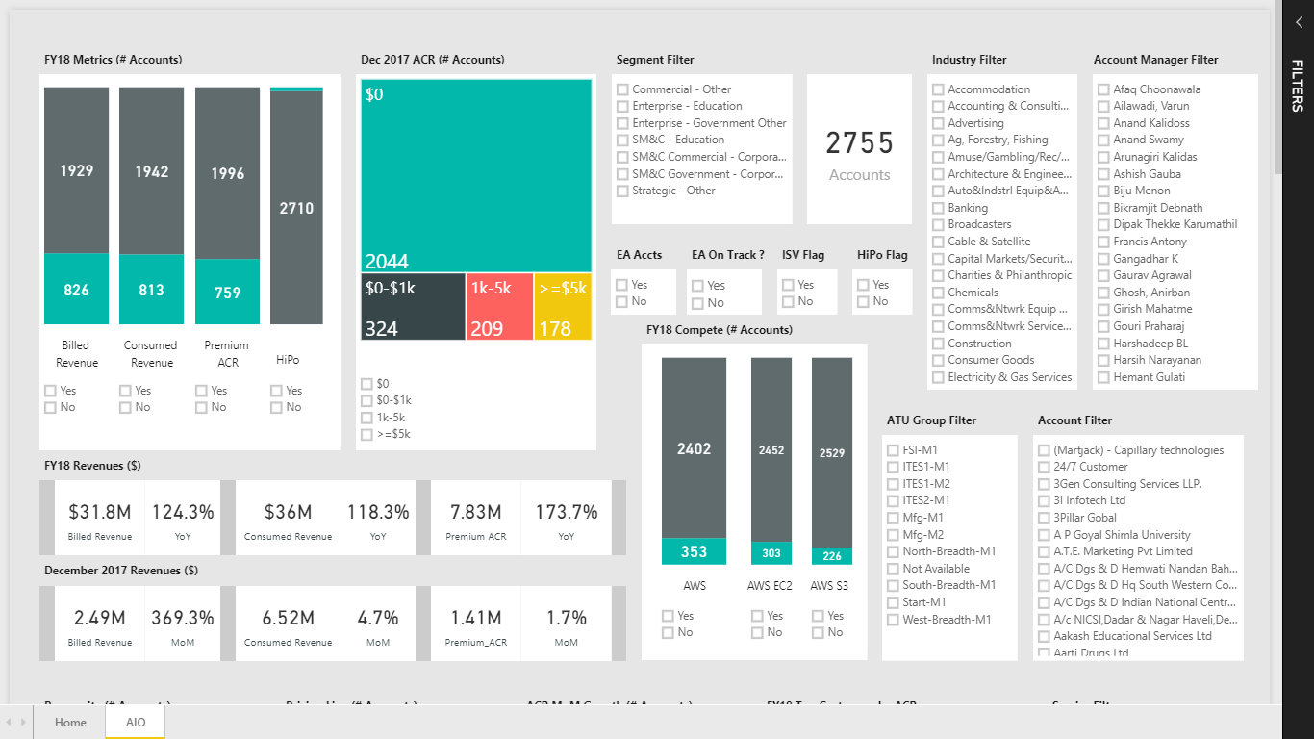
All-In-One Power BI Dashboard
A multinational technology client
The Problem: No single dashboard available to provide unified view on the cloud platform
The “Before” State
LatentView Solution
The “After” State
Data for cloud platform was scattered across different sources and reports making it difficult and complex for different teams to acquire relevant details to proceed with sales play and targeting exercises.
Consolidated all available targeting intelligence on cloud platform into a single dashboard to facilitate better data driven targeting and marketing . This aligned the Cloud Platform business to the FY18 goals
Huge amount of time savings across streams that enabled proactive actions
Removed the need for small ad hoc data requirements
Gives a strategic level viewpoint of Cloud Platform Business
Select the metrics on which the charts has to be filtered
Actionable parameters like Churn Risky, Growth Potential, Slow Growth and Immediate Action required accounts
Functionality to export data to excel for analysis
Back

Slide 22












Data Harmonization for Efficient Digital Supply Chain
World’s Largest Entertainment production company
The Problem: For digital content that contributes $4 billion in revenue, the weak link in the supply chain is the nature of data pipeline which in the correct state is rigid & fragmented
The “Before” State
LatentView Solution
The “After” State
The supply chain starting from digital content request to going live is tracked using multiple silo data sources and requires skilled executives to monitor for revenue leaks
Built an data ecosystem from multiple disjointed unstructured and structured data sources by leveraging AWS cloud platform for big data, thus providing a monitoring platform
The solution helped in ensuring on-time delivery of the digital contents and thus, saved half a million dollar per year from revenue leaks
SQL Server
DMS
(ongoing replication)
S3 buckets
(encrypted)
Redshift
MarkLogic
GLUE
Tableau Server
Internet
Azure
Lambda
EC2 (Bastion Host)
DBA
Back
22

Slide 23
Thank You!
Do You Have Any Questions?
www.LatentView.com
| Princeton | San Jose | Seattle | London |
Chennai | Singapore |

